Slide 1
Sudan Water cleaning project
By
Bilal Blake
&
Breanna Straker

Slide 2
About Sudan
Sudan is located in the Sahel region of Africa
Sudan suffers from inadequate portable water supplies, which gives rise to problems such as periodic droughts, soil erosion and desertification. Due to excessive hunting, the wildlife population is threatened.
The ox-driven water wheel that has been in operation since 400 BC still plays a vital role in the economy of the country

Slide 3
Our problems/ Materials
Problem
Materials
Some places in Sudan have no clean water
My group had designed a water filter made of recycle objects
2 bottles
Cotton balls
Old panty wholes
Paper towel
Pebble rocks
Cloth
Sand
Still wool

Slide 4
Observations
Nov:15
The Dirty water became more translucent
Nov:18
There is no more water particles inside of the dirty water
Nov: 20
We got rid of the stocking and replaced it with a sock then put a bottle cap on the bottom with holes.
Nov:21
It became more translucent
Dec:3
We used rocks, sand, and cotton and got rid of everything else. Also the water became luminous.

Slide 5
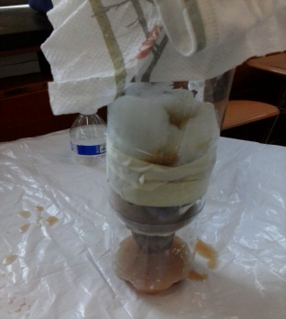
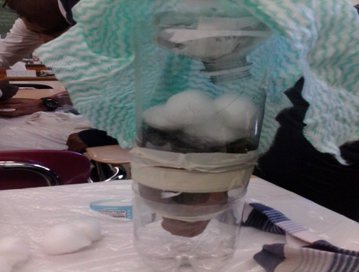
OBservations
Notes:
This three pictures show the process we took in using our different materials to make water cleaner for Sudan. We used different types of materials until we can get a cleaner color of water.

Slide 6
Before /after

Slide 7
In conclusion
We had got the water to be clear but now we need to check the water for dirty particles. Water can be dirty and look clean.

